Slide 1
PROJECT REPORT on “CLEAN-Fi TOOL”

Slide 2
ABSTRACT
The solar power is the most abundantly available energy on the earth with growing cost of electricity and for the environmental of fossil fuels implementation of eco-friendly energy sources like solar power are rising.
The main method for harnessing the solar power is with arrays made up of solar panel. Accumulation of dust and debris on even one panel in an array reduce their efficiency in energy generation so we need to keep the panel surface area as clean as possible. Current labor bared cleaning method for solar arrays are costly in time, water and energy usage and lack of automation capabilities. Number of robots can be interconnected through internet of thing and their operation can be monitor by a device. for ex. Mobile.

Slide 3
We can popup current status of rooftop system ON and OFF it will be send message to the user for alert. It can clean and moreover on the glass surface of solar panel of varying angle with help of ARDUINO/NODEMCU. The dirt and bird feces make a spot in the panel, and it can make temporary foil in the panel. Dry cleaning can be possible to remove on panel, it can remove with help of water .This project deals with “change in efficiency brought about by the cleansing of the solar panel array”.

Slide 4
OBJECTIVES
Project Goals:
Design a cleaning mechanism that runs across the flexible length of the panels.
Design a control circuit for cleaning mechanism.
Improve overall solar panel efficiency.
Features:
One-time installation.
Effective wiping system.
Easily replaceable wipers.

Slide 5
NEED OF PROJECT
Loss of efficiency of clean c-Si PV cells is attributed to two factors: an initial degradation in the first few days of exposure to sun light, a long-term degradation due to aging. The former is estimated at 2.6% ± 1.3% and it is manufacturer -related while the latter is due to degradation of silicon or solder joints and water ingress and ranges between 0.3–0.8% per year.
A number of environmental factors such as wind speed, humidity, ambient temperature, solar radiation, atmospheric dust and direction influence the power generation process using installed solar photovoltaic modules. Dust build-up on solar module surface is an issue of great worry, particularly in desert provinces where infrequent to regular dust storms do occur. The glass cover transmittance decreases because of accretion of dust on the surface of PV module, which ultimately decreases the amount of solar irradiation reaching the cells.

Slide 6
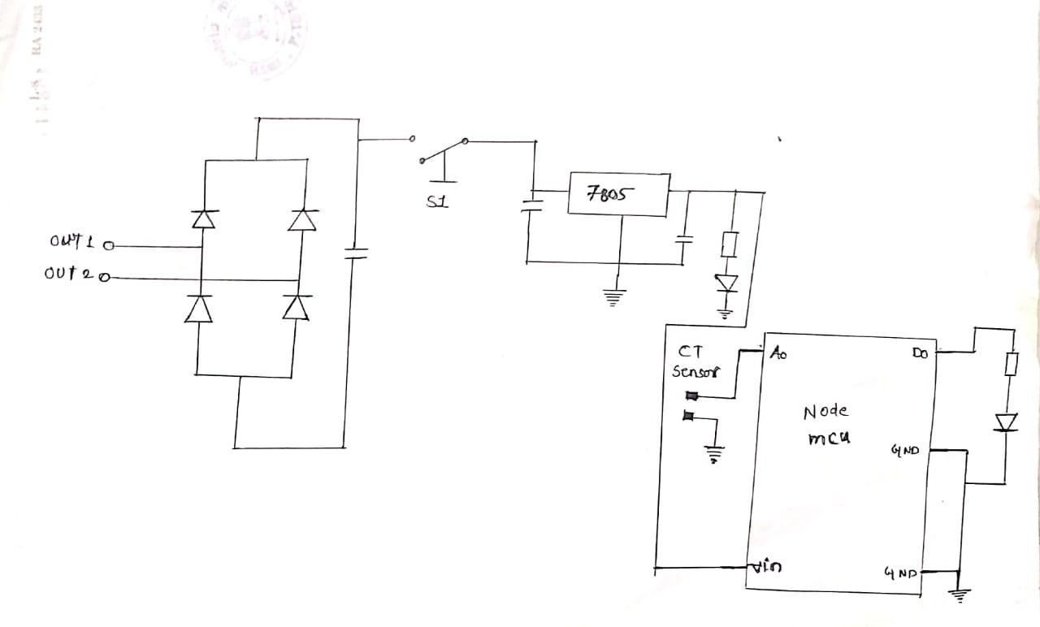
SCHEMATIC DIAGRAM

Slide 7
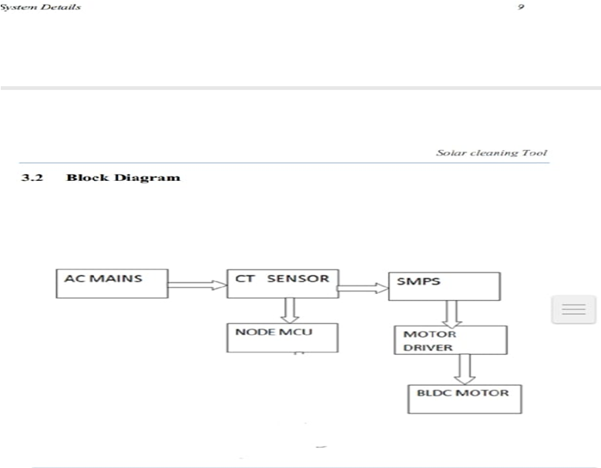
BlOCK DIAGRAM

Slide 8
Data storage and transfer flow

Slide 9
Backend programming Interface

Slide 10
Prototype Result

Slide 11
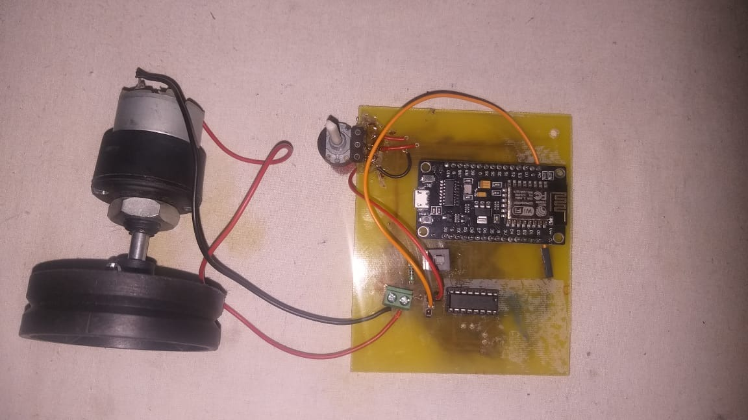
Prototype

Slide 12
CONCLUSION
With rising implementation of photovoltaic arrays, a new method of cleaning and inspection is necessary. Complete cleaning is especially important since the obstruction of a single panel with debris affects the energy generation for the entire array. It is extremely important that all cells operate at peak efficiency since they are connected in series.
Advances in energy technology should be accompanied by advances for their support, maintenance and inspection devices The device developed significantly reduces the number of workers needed to clean arrays using limited resources and taking less time. Further development will optimize the system to be smaller, lighter, easier to assemble in higher volume and more user-friendly. But the next focus will be inclusion of auto inspection, communication, and self-diagnostic features to diversify the robot’s functionality.

Slide 13
FUTURE SCOPE
CVTs are still in its early development stage.
It’s applications are growing exponentially due to its advantages.
CVT tuning can improved with applying machine learning algorithm like linear regression on the data collected through our system to predict perfect parameter for optimized performance of the CVT.

Slide 14
REFERENCES
www.researchgate.com/publication/335117222_Comparative_investigation_of_tool_wear_mechanism_and_corresponding_machined_surface_ch
www.researchgate.net/scientific-contributions/20515826_Andrew_Walenstein
www.researchgate.net/publication/318176181_Iterative_Enhancement
Notes:
https://www.researchgate.net/publication/335117222_Comparative_investigation_of_tool_wear_mechanism_and_corresponding_machined_surface_characterization_in_feed-direction_ultrasonic_vibration_assisted_milling_of_Ti-6Al-4V_from_dynamic_view

Slide 15
THANK YOU..!

